Slide 1

USED CAR PRICE PREDICTION PROJECT
Submitted by:
Jessica Ghimeliya
Hnh

Slide 2

Agenda
Introduction
Problem statement
Tools used
About dataset
Data sources and there format
Data preprocessing
Outlier and skewness removal
Model building
Select best model
Hyperparameter tuning
conclusion

Slide 3
Introduction
Car price prediction especially when the vehicle is used and not coming direct from the factory, is both a critical and important task.
With increase in demand for used cars more and more vehicle buyers are finding alternatives of buying new cars.
There is a need of accurate price prediction mechanism for the used cars. Prediction techniques of machine learning can be helpful in this regard.
It is common to lease a car in many countries rather then buying a new car.
So with building of model with different machine learning algorithms.
Respective performances of different algorithms were then compared to find one that best suits the available data set.

Slide 4
Problem statement
One of our clients works with small traders, who sell used cars. With the change in market due to covid 19 impact, our client is facing problems with their previous car price valuation machine learning models.
So, they are looking for new machine learning models from new data. We have to make car price valuation model. This project contains two phases: -
Data collection phase: In data collection process I had scrap the data from cars24.com and through selenium and converting that into structured format.
Model Building phase:
Data Cleaning
b) Exploratory Data Analysis
c) Data Pre-processing
d) Model Building
e) Model Evaluation
f) Selecting the best mode

Slide 5
Tools used
Hardware and Software Requirements and Tools Used
Notebook and Data:
GitHub, Jupyter Notebook
Libraries:
Numpy
Pandas
Sklearn
Scipy
Joblib
Matplotlib
Seaborn
statsmodels

Slide 6
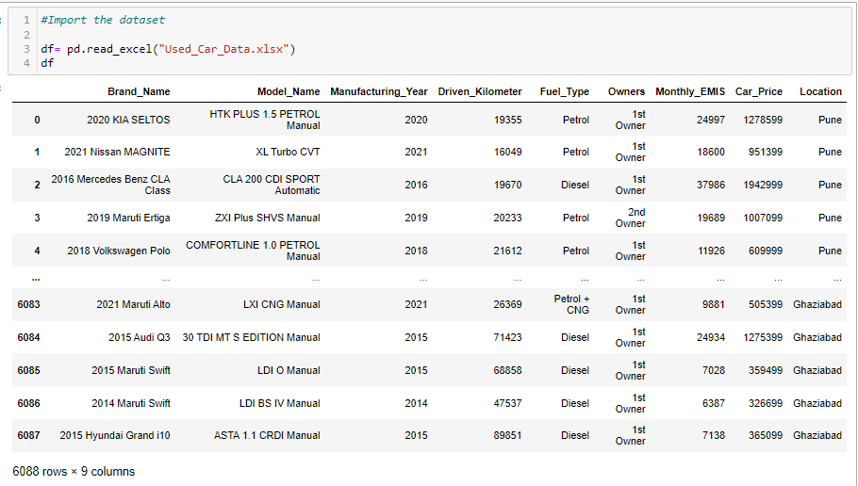
About dataset
The dataset contains 5487 rows 8 columns
Importing necessary libraries
After importing dataset the dataset will be look like,

Slide 7
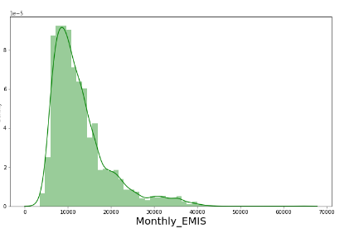
Data sources and there format
We can see there are no null values present in whole dataset.
We can find here only four columns are having object data types and rest four columns are having integer datatype.
What is easiest monthly pay EMI according to sites?
Maximum cars are having MONTHLY EMIS in between
10000rs to 20000rs with
peak of 10000rs

Slide 8
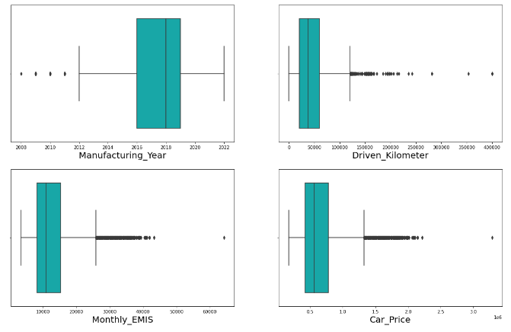
Data sources and there format continue..
Driven Kilometers, Monthly EMIS columns are having outliers which we need to treat that with z score technique which removes the outliers

Slide 9
Data preprocessing
Block diagram of data preprocessing
1.Drop unnecessary columns
2.Filling missing value
3.Encode the object datatype
4.Outlier detection
5.Skewness removal

Slide 10
Outlier and skewness removal
In this dataset we don’t have any missing value.
Drop that columns which are having poor correlation with target variable.
Encode the object datatypes columns with label encoder.
Use that technique outlier removal technique through which less data will be loss.
I had use z score technique
For continuous columns which are having skewness value greater than +0.5 to -0.5 then it is important to remove skewness from that.
Method used : yeo_johnson

Slide 11

Model building

Slide 12
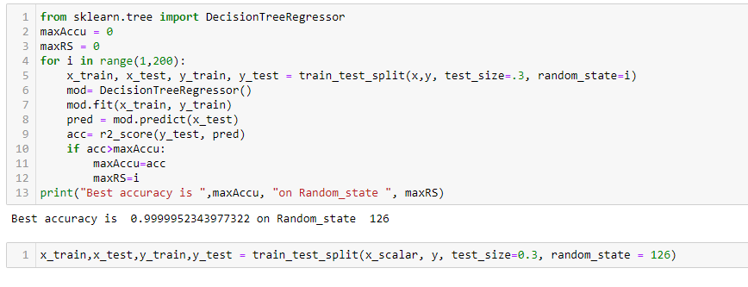
Model building
Find best random state
k
Train test split
Model building
R2 score
According to output best random state is 126 with 99.99% best accuracy.
Cross validation score

Slide 13
Model Building
Find best random state
Train test split
Model building
Train test splitting of data with best random state.
R2 score
Cross validation score

Slide 14
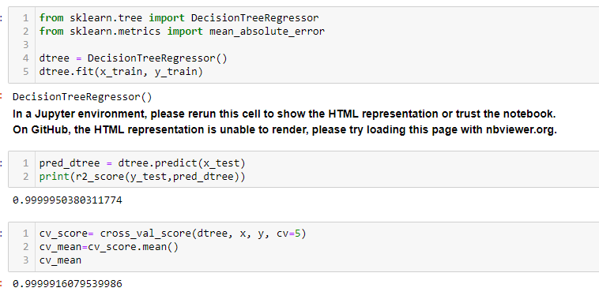
Find best random state
Train test split
Model building
R2 score
We get 99.99% accuracy after using decision tree regressor algorithm
Cross validation score

Slide 15
Selecting best model
Comparison of models
Decision tree classifier model is having minimum difference between cross validation score and r2accuracy score, so Decision tree classifier is a best model.
Sr. No. | Algorithms | Accuracy score (a) | Cross -Validation Score(b) | Difference (a-b)
1. | Linear Regression | 90.56% | 90.14% | 0.42%
2. | Random forest regressor | 99.9997% | 99.9993% | 0.00032%
3. | Decision Tree Regressor | 99.9995% | 99.9993% | 0.0003%

Slide 16
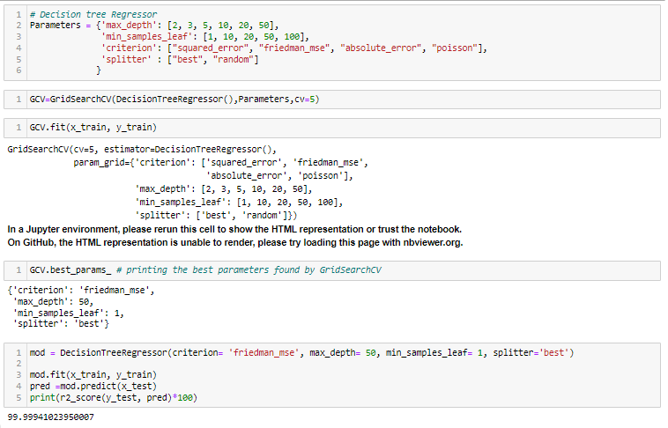
Hyperparameter tuning
Grid search cross validation (GCV) in hyperparameter tuning will help us to finding the best parameter and tune it with training data set and give best accuracy score
After hyperparameter tuning the accuracy score is remain to : 99.999%

Slide 17
Conclusion
As we see our model is having minimum difference between accuracy score and cross validation score. So, decision tree Regressor is best model with accuracy score is: 99.99%
We fit our training data into the hyperparameter tunning model and check for accuracy .
We got an accuracy of 99.99% which is amazing.

Slide 18
Thank You

